Slide 1

UNIVERSITY INSTITUTE OF ENGINEERING
COMPUTER SCIENCE ENGINEERING
Bachelor of Engineering (Computer Science & Engineering)
Subject Name: Big Data Analytics
Subject Code: 20CST-471
Introduction to Hadoop
Mapped with CO2
Prepared By:
Er. Ankita Sharma
DISCOVER . LEARN . EMPOWER

Slide 2
Introduction to Hadoop
Hadoop is an open-source framework designed for distributed storage and processing of large data sets.
It provides a scalable, reliable, and fault-tolerant solution for handling big data across clusters of commodity hardware. The project is managed by the Apache Software Foundation and has become a foundational technology in the field of big data analytics.

Slide 3
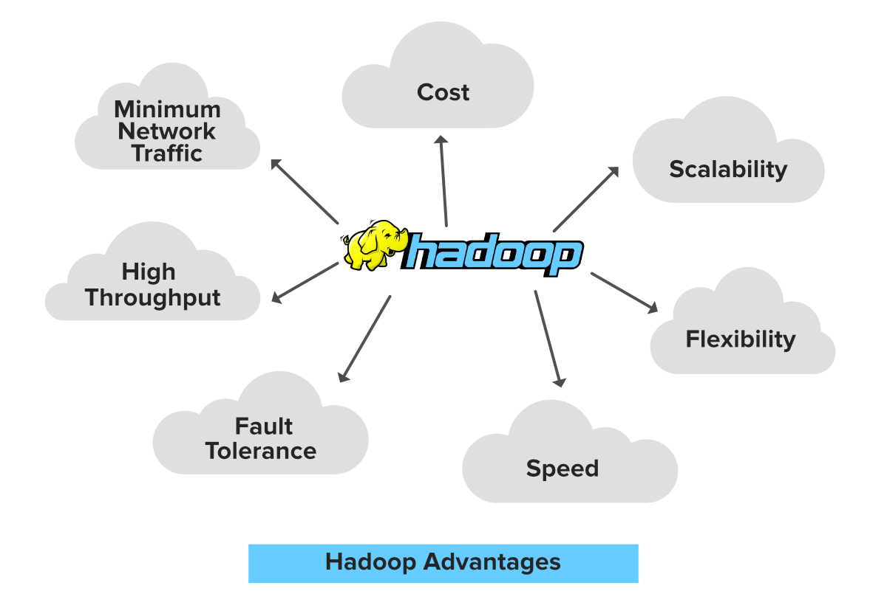
Key Components of Hadoop:
Hadoop Distributed File System (HDFS):
HDFS is the primary storage system used by Hadoop. It breaks large files into smaller blocks, distributes them across nodes in a cluster, and replicates them for fault tolerance.

Slide 4
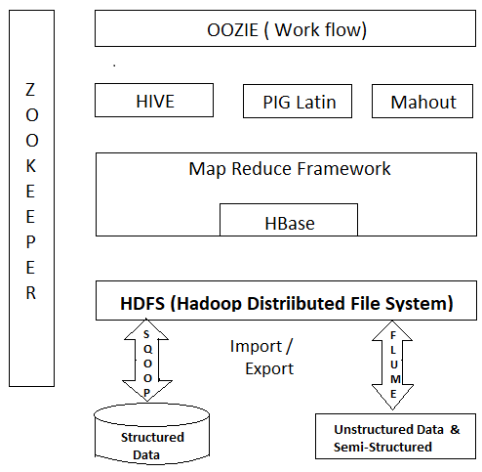
Map Reduce:
Map Reduce is a programming model and processing engine for distributed data processing. It allows the parallel processing of large datasets by breaking tasks into map and reduce phases.

Slide 5
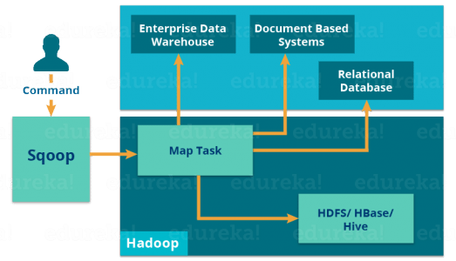
YARN (Yet Another Resource Negotiator):
YARN is a resource management layer that separates the job scheduling and resource management functions. It enables multiple applications to share resources in a Hadoop cluster.

Slide 6
Core Concepts of Hadoop:
Scalability:
Hadoop is designed to scale horizontally, allowing organizations to add more nodes to the cluster as data and processing requirements grow. This scalability makes it suitable for handling large and diverse datasets.
Fault Tolerance:
Hadoop ensures fault tolerance through data replication. Each data block is replicated across multiple nodes, so if one node fails, the data is still accessible from other replicas.
Data Locality:
Hadoop leverages data locality, meaning that computation is performed on the same node where the data resides. This reduces the need for data transfer across the network, improving processing efficiency.

Slide 7
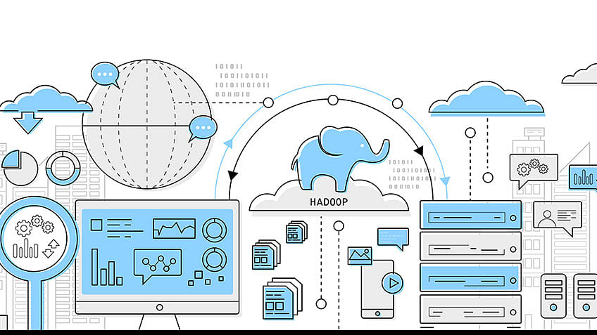

Slide 8
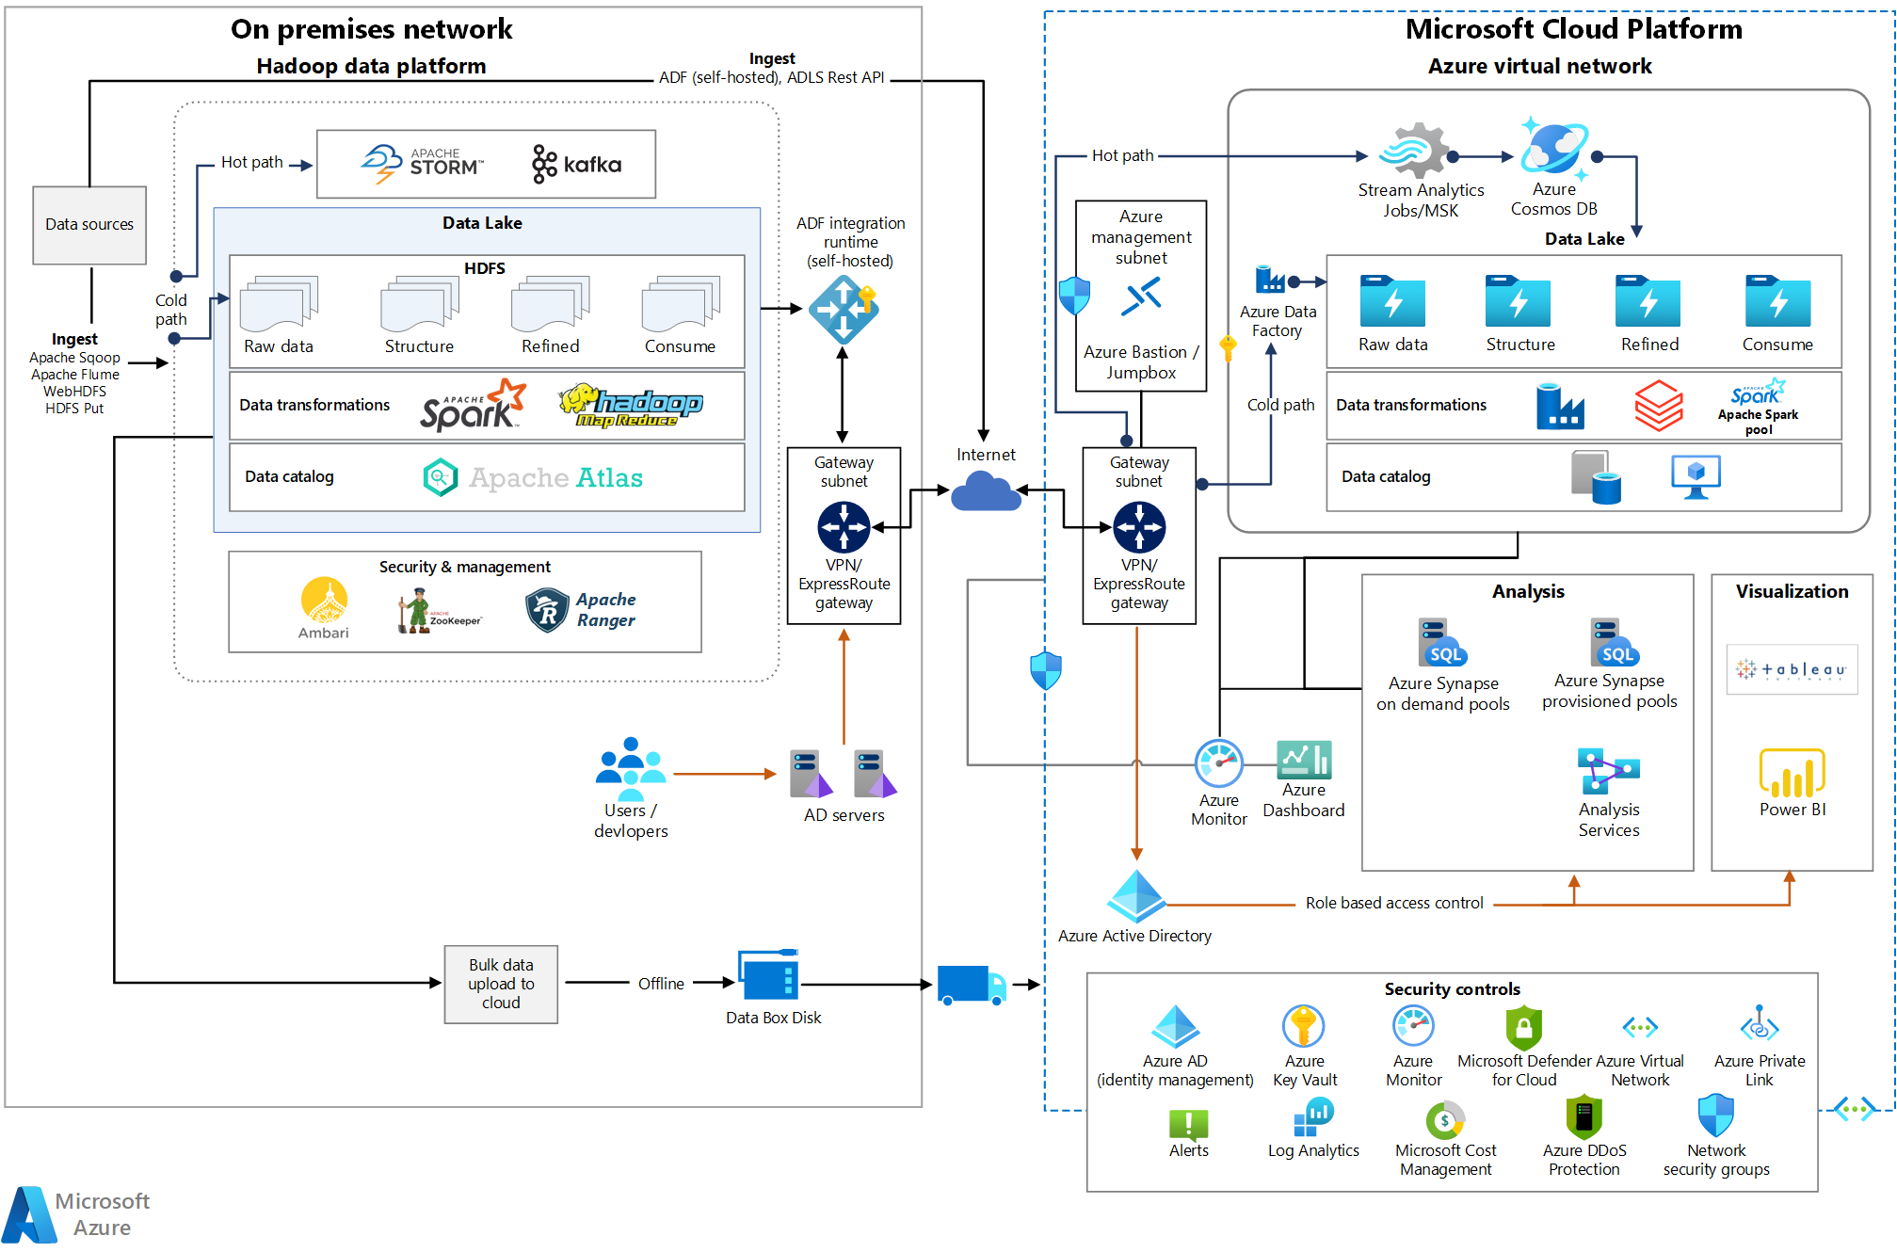

Slide 9
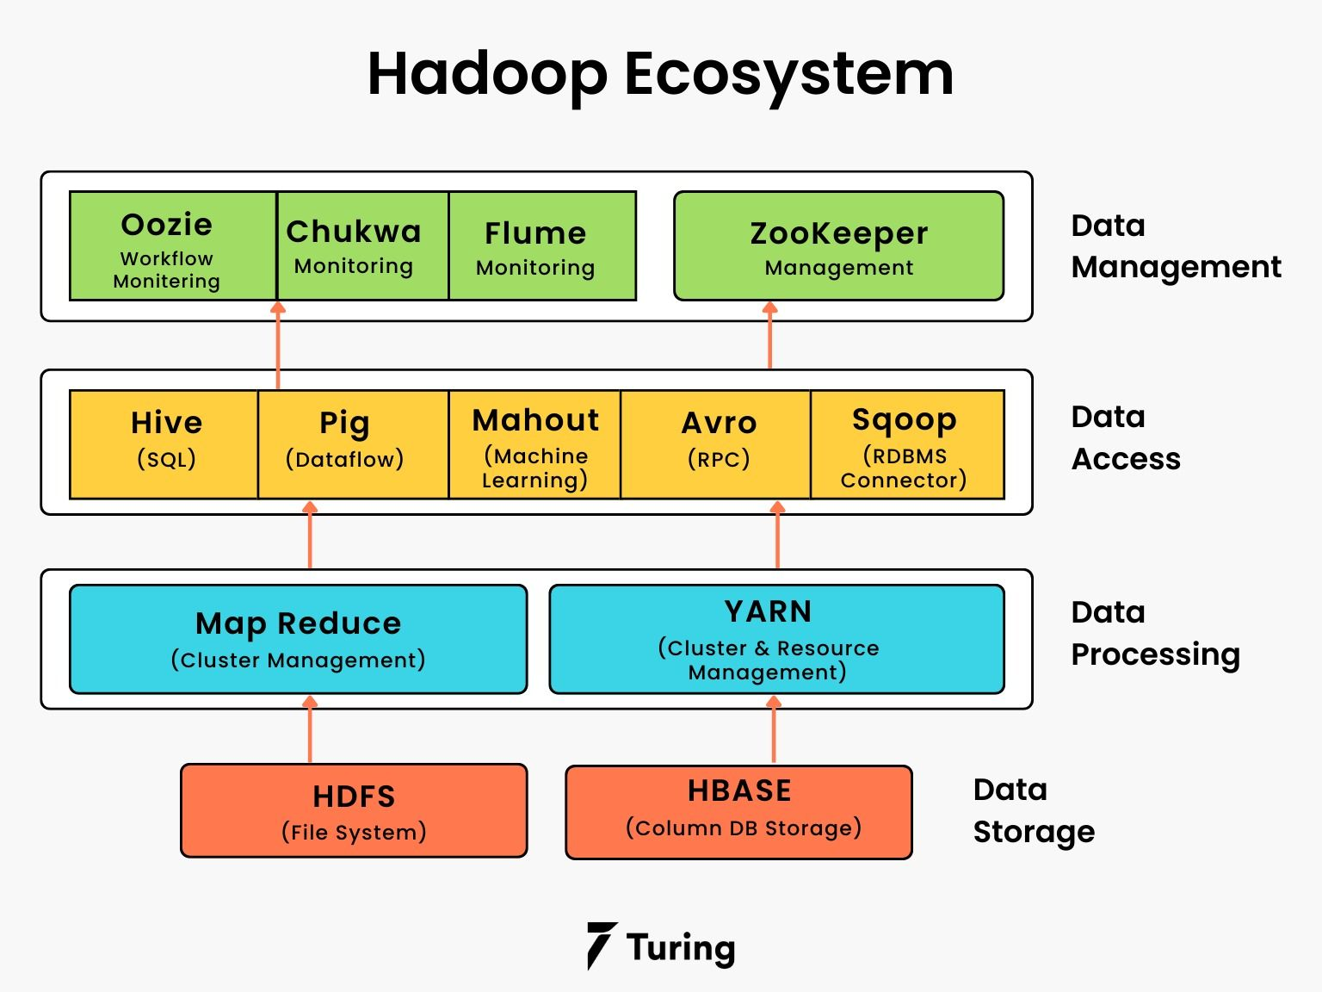

Slide 10
Thankyou

